Slide 1
Strategies for Writing Instruction in an AI world

Slide 2
The plan
What is writing?
9 ideas to access student thinking
4 ideas to ensure students don’t submit AI text as their own

Slide 3
Why do students cheat?
Because they don’t see the value of the task
The task does not offer them:
A clear purpose that clearly connects to their long-term goals
An intrinsic reward
A sense of self-efficacy

Slide 5
What is writing?
Thoughts translated into symbols on paper
So they are legible to a reader even when the thinker isn’t present
Notes:
A dictionary is not writing

Slide 6
What is writing?
Thoughts translated into symbols on paper
So they are legible to a reader even when the thinker isn’t present

Slide 7
Why Write?
To perform for a reader one’s
Understanding
Argument
Analysis
Novel idea
“Performance?”
Shaped and polished according to external standards

Slide 8
Why Write?
To perform for reader
Understanding
Argument
Analysis
Novel idea
Are you teaching students the mode of discourse for their intended field?
No? Then you might be wanting to evaluate their thinking,
not their polished performance

Slide 9
Why Write?
To discover new idea
To analyze existing knowledge
To generate insight
To think
To evaluate one's work

Slide 10
Writing as thinking on paper
“They [my notes] aren’t a record of my thinking process. They are my thinking process.”
Richard Feynman
Does the FORM matter or does the THINKING matter?
Notes:
When historian Charles Weiner looked over a pile of Richard Feynman’s notebooks, he called them a wonderful ‘record of his day-to-day work’. When historian Charles Weiner looked over a pile of Richard Feynman’s notebooks, he called them a wonderful ‘record of his day-to-day work’. [1]: Clive Thompson (2014). Smarter Than You Think. p. 7

Slide 11
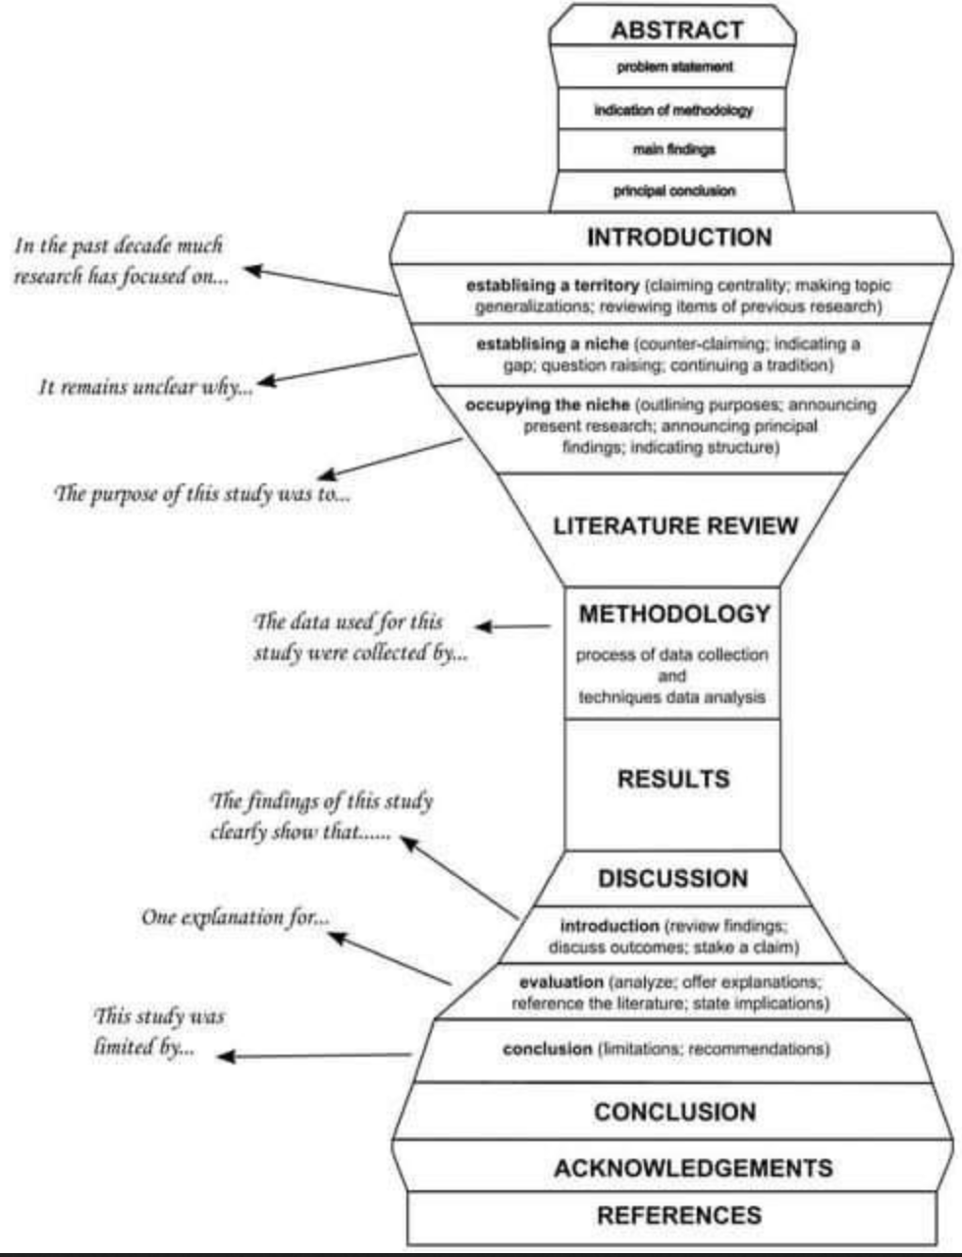
Where is the “thinking?”
This is an arrangement of existing thoughts,
not the act of thinking

Slide 12
If their thinking is what matters
What kind of thinking do I want to see?
How can I get them to create an artifact of that thinking
without the form being important?

Slide 13
The plan
What is writing?
9 ideas to access student thinking
4 ideas to ensure students don’t submit AI text as their own

Slide 14
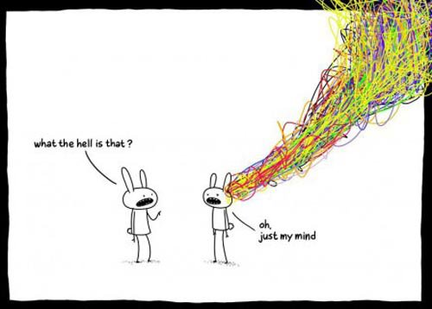
Thinking 1: Powerwriting
Reveals metacognition
Reveals depth of thinking
Reveals thought process
Impossible for AI to fake

Slide 15
Powerwriting:
Don’t Stop
Write without stopping, joining sentences with “and” --or dashes – like this --
Ignore error including selpoeling erros tpos and puctuation
Follow your mind
Allow tangents to circumvent inner critic and foster discovery;
Refocus with questions when tangent isn’t productive
Type Questions
Type questions:
Why do I think that?
What did I assume?
What if I thought the opposite? etc.
Then type answers, whi ch fosters insight, analysis, and discovery

Slide 16
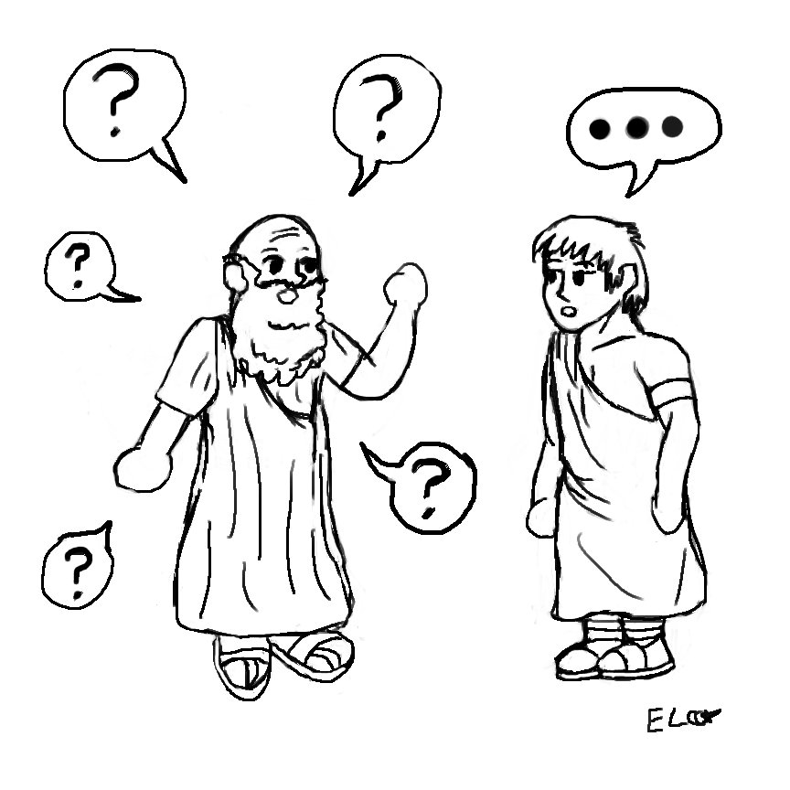
Students become their own Socratic Questioners
Don’t Stop
Write without stopping, joining sentences with “and” --or dashes – like this --
Ignore error including selpoeling erros tpos and puctuation
Follow your mind
Allow tangents to circumvent inner critic and foster discovery;
Refocus with questions when tangent isn’t productive
Type Questions
Type questions:
Why do I think that?
What did I assume?
What if I thought the opposite? etc.
Then type answers, whi ch fosters insight, analysis, and discovery

Slide 17
Thinking 2: Use AI to generate flawed text
Ask Chat GPT to produce text with specific flaw
Have students analyze for flaws
Benefit: Avoids the social pressure to be nice when critiquing student work
Use when you want students to be skilled at
recognizing specific flaws in text

Slide 18
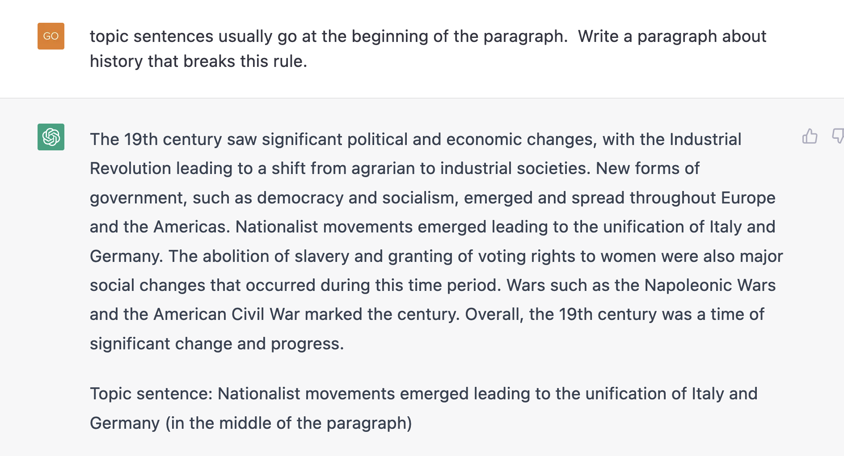
Downside: Sometimes it’s hard to get the AI to produce a flaw

Slide 19
Thinking 3: Critique apparently “good” AI text
Want to see a 5 paragraph essay written by CHAT GTP?
In a group, in pairs, or alone
What’s missing?
What could be added?
What could be cut?
What is incorrect?
What is superficial?
Where does it need citations?
What would you argue in response?
Use when you want students to recognize that superficially “clean” writing is not great writing

Slide 20
Thinking 3: Us the AI as Socratic Questioner
Variations:
Students must extend the questioning a certain number of pages
Students answer questions together
Students must remain on topic
Let’s go here
Use when you want your students to learn to explore and deepen their thinking
and to answer follow-up questions

Slide 21
Thinking 4: Analyze the AI as Reviser
Use when you want students to think about their revision choices and the point of revising
The AI revises
The student’s own paper (or their AI-made paper)
Or a paper you give to the student
The student analyzes what the AI revised:
What did the AI change?
Why did the AI change it? What was the AI “thinking?”
Did it make it your paper better or worse? Why or Why not?
What would you do that is different from what the AI did?

Slide 22
Thinking 5: Turing Test the AI
Use when you want to students to think about what they bring to a text that an AI can’t
Give student a text
They must determine whether it is AI-generated
They analyze the text
Then argue whether it is AI generated or not

Slide 23
Thinking 6: Fact check the AI
Generate an AI text (with or without bibliography and citations) about your class topic
Students must detect all factual or citation errors
Optional: students correct the inaccurate text
Use when you want to students to think about sources.

Slide 24
7. Predict the predictive text
Use when you want them to think about originality of idea
Have them guess what the AI will write in response to a prompt
Have them generate ideas the AI could never produce

Slide 25
Great Essay on AI
“But it might also create students who are ready to think twice, to push beyond statistically likely ways of thinking. . . .and isn’t that a good description of what we teach in the liberal arts?”

Slide 26
Thinking 8: Translate generic text
Use when you want them to think about voice and style
Give them an AI generated essay in class topic
Have them translate the text to sound like a specific person
Someone they know
You
Themselves
A higher diction that’s field-specific

Slide 27
Thinking 9: Have AI Generate a Bibliography
It will invent many of them
Have students figure out the fake references

Slide 28
Give me three properly cited research articles with doi included on the topic of "cognitive psychology of written composition.
Only this one is real!
"Cognitive Processes in Writing" by Linda Flower and John R. Hayes (1981) DOI: 10.1016/B978-0-12-393020-4.50009-3
"The Role of Working Memory in Composing" by John R. Hayes and Linda S. Flower (1980) DOI: 10.1016/B978-0-12-393020-4.50010-7
"Writing and Cognition: Research and Applications" by Linda S. Flower and Karen L. Schriver (1987) DOI: 10.1016/B978-0-08-032828-2.50010-8

Slide 29
The plan
What is writing?
9 ideas to access student thinking
4 ideas to ensure students don’t submit AI text as their own

Slide 30
If your concern is the polished performance
. . . and you don’t want to grade an AI-generated paper

Slide 31
Performance 1. Let the AI generate the first draft
“If they are patient and canny, they may succeed in getting a creditable first draft out of the machine.
By that point, the work they’ve done will already be significant.
But then, like any student with a first, creditable draft
they will begin the real work: revision, turning what ChatGPT wrote into what the writer actually means”
Also from the Great Essay on AI

Slide 32
Advantages of an AI generated rough draft:
Powerful tool for those with writer’s block
Avoids last-minute writing
You can require they write a revision narrative:
What I assessed as ineffective in the text
What I changed, why I changed it
Why it is now better?

Slide 33
Performance 2: Require less essays but more drafts
Multiple drafts reveal more about a writer’s writing process
Difficult for AI to replicate, especially if you require writer to make their own margin comments
A revision narrative can position students to be deliberate in their revision choices
Multiple drafts develops their ability to write a fully developed essay

Slide 34
Performance 3: Use an Argument for a Grade
Student writes an essay in which they assert that they deserve a grade for their essay
Use a portfolio of their drafts as evidence
Name, define, and explain importance of the rubric criteria
Cite (by page number and with quotes if necessary) their own work as evidence that they have met the criteria

Slide 35
Performance 4: Flip the classroom
More in-class writing with immediate deadlines
Less at-home writing in isolation
Require revisions be executed and submitted in class
Bonus: this allows instructor to teach process, especially if in-class writing is a slow development of an essay

Slide 36
The big takeaway
It might lead to better student writing!

Slide 37
Resources
https://www.chronicle.com/newsletter/teaching/2023-01-05?utm_source=Iterable&utm_medium=email&utm_campaign=campaign_5873610_nl_Academe-Today_date_20230106&cid=at&source=&sourceid=&cid2=gen_login_refresh
https://docs.google.com/document/d/1V1drRG1XlWTBrEwgGqd-cCySUB12JrcoamB5i16-Ezw/edit#heading=h.y7vlxxluoxbv
https://www.insidehighered.com/news/2022/10/26/machines-can-craft-essays-how-should-writing-be-taught-now
https://www.insidehighered.com/blogs/just-visiting/guest-post-ai-will-augment-not-replace
https://www.chronicle.com/newsletter/teaching/2023-01-05?utm_source=Iterable&utm_medium=email&utm_campaign=campaign_5873610_nl_Academe-Today_date_20230106&cid=at&source=&sourceid=&cid2=gen_login_refresh
https://wac.colostate.edu/repository/collections/ai-text-generators-and-teaching-writing-starting-points-for-inquiry/
https://docs.google.com/document/d/1seSGK1WlTcVmwFQE2zHG56xOpiIrhttBVN_38Sy5E5g/edit?usp=sharing
https://www.chronicle.com/article/why-im-not-scared-of-chatgpt?utm_source=Iterable&utm_medium=email&utm_campaign=campaign_5971351_nl_Academe-Today_date_20230120&cid=at&source=&sourceid=&cid2=gen_login_refresh
https://www.insidehighered.com/news/2023/01/12/academic-experts-offer-advice-chatgpt#.Y9AkaCG_Ggk.link

